Slide 1
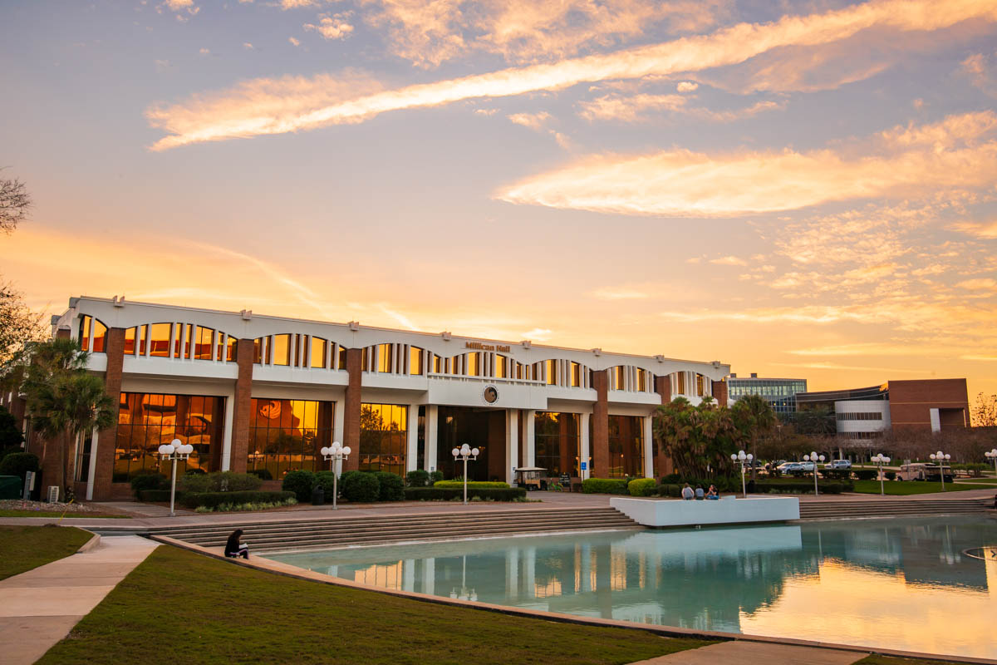

UCF Contact Manager

Slide 2
The Team
Scott: Project Manager/API
Collin: API/Testing
Mason:
API/Database
Sam: Frontend
Nick: Frontend
Nicole: Frontend

Slide 3

Server-Side
LAMP Stack
MySQL
PHP
DigitalOcean - Hosting
API: Postman initially, then ARC

Slide 4
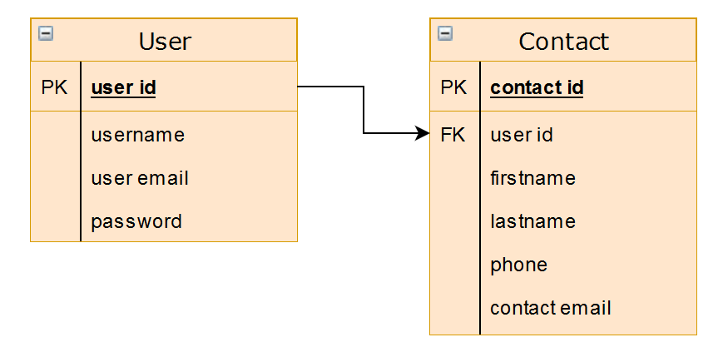
Entity Relationship Diagram

Slide 5

Front-End
JavaScript
HTML
CSS

Slide 6
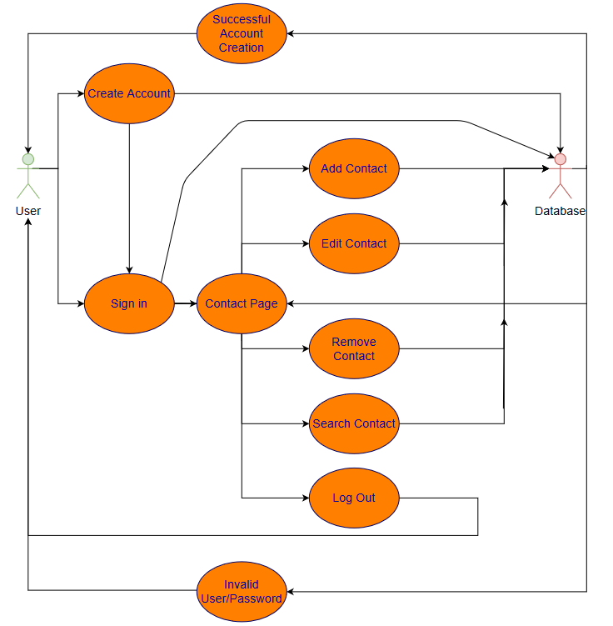
Use Case Diagram

Slide 7



Supporting Tools
Discord – Communication
Weekly Coding Jams
GitHub – Version Control/Code Sharing
JIRA – Project Management/Deadlines
Kanban

Slide 8
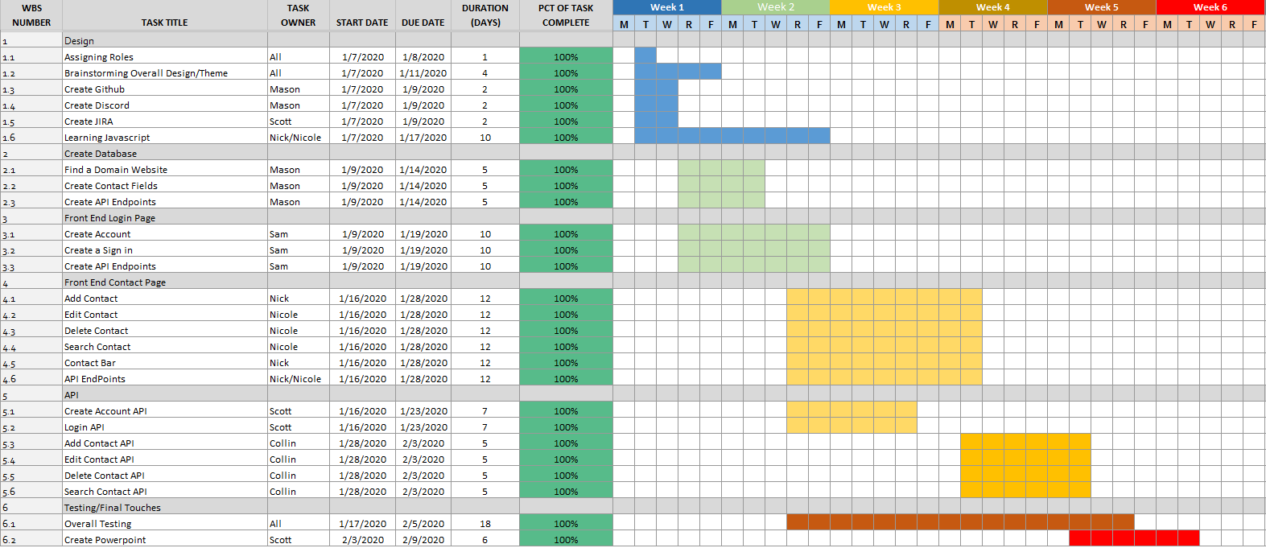
Gantt Chart

Slide 9

UCF Contact Manager Demo

Slide 10
What Went Well and What Did Not
What went well
Communication
Background and experience
Time management
What did not go well
Learning curve
API
Getting everything together

Slide 11

Questions?

